Slide 1
MARKETS
A market is a place where two or more parties can meet to engage in an economic transaction.

Slide 2
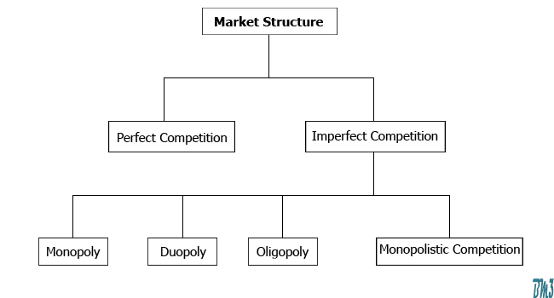
TYPES OF MARKETS 0R MARKET STRUCTURES

Slide 3
PERFECT COMPETITION Vs IMPERFECT COMPETITION
Perfect Competition is a type of competitive market where there are numerous sellers selling homogeneous products or services to numerous buyers
Imperfect Competition is an economic structure, which does not fulfil the conditions of the perfect competition

Slide 4
MONOPOLY
Mono means single; Poly means Seller.
Only one seller will be available in this market variety
Features of a Monopoly:
Single seller and numerous buyers
No close substitutes
No distinction between Firm & Industry
Entry and exit barriers will be available
Monopolist will be acting as a price maker/fixer.
Information will be exchanged

Slide 5
Oligopoly
The word "oligopoly" comes from the Greek oligos, meaning "little or small" and polein, meaning "to sell."
Oligopoly is a market sector in which there are only a few sellers. It is often referred to as competition among the few.
Examples:
Automobile manufacturers
Cell phone providers
Commercial air travel
Media outlets
Music Industry
Oil and gas industry
Telecom industry
Search engines
Social media
Steel production
Tobacco Industry
Book publishing etc

Slide 6
Features of Oligopoly
Few sellers and numerous buyers
Barriers to entry of firms
Homogenous or distinct product
Interdependence
Advertising
Competition
Lack of uniformity
Existence of price rigidity

Slide 7
PERFECT COMPETITION
Features:
Large number of sellers and buyers
Homogeneous products are being traded
No entry and exit barriers
Firm and industry are entirely different
Firm will be acting as a price taker
Information will be exchanged
Factors of production are perfectly mobile

Slide 8
MONOPOLISTIC COMPETITION
Features:
Large number of sellers and buyers
Product differentiation
Free entry and exit of firms
Absence of interdependence
Information will be exchanged

